Slide 1

Pengantar Geospatial Data Science dan Artificial Intelligence
February 12, 2021
Geospatial Data Science Crash Course
Dany Laksono
Departemen Teknik Geodesi UGM

Slide 2

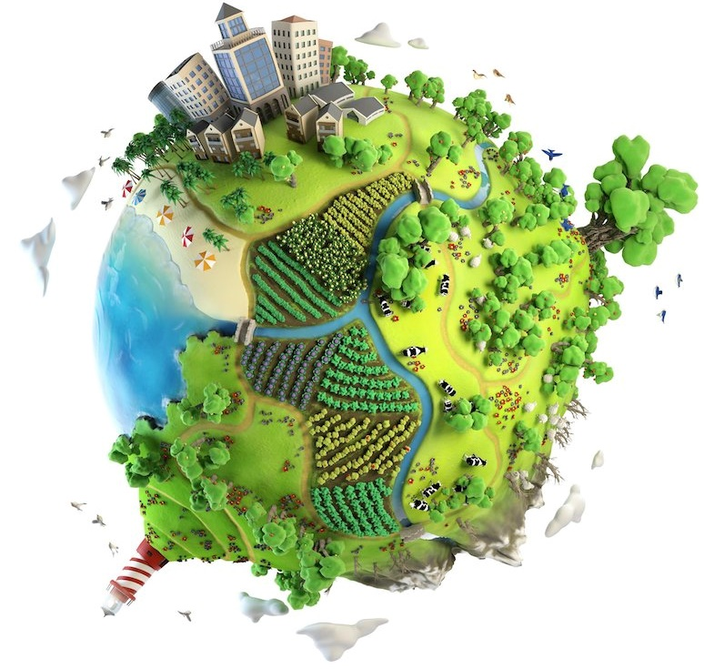
Pengantar Geospatial Data Science dan Artificial Intelligence
Data Science dan Artificial Intelligence
Geospatial Data Science
Pengantar Pemrograman Python
Jupyter Notebook dan Google Colab
Mengenal modul-modul Python untuk Data Science

Slide 3
Tentang Pelatihan Ini
Intro to Data Science
Machine Learning
Deep Learning

Slide 4

“Barangsiapa yang menganggap perjalanannya panjang, niscaya langkahnya akan melemah”
(Ibnul Qayyim, Al-Fawa’id: 90)

Slide 5
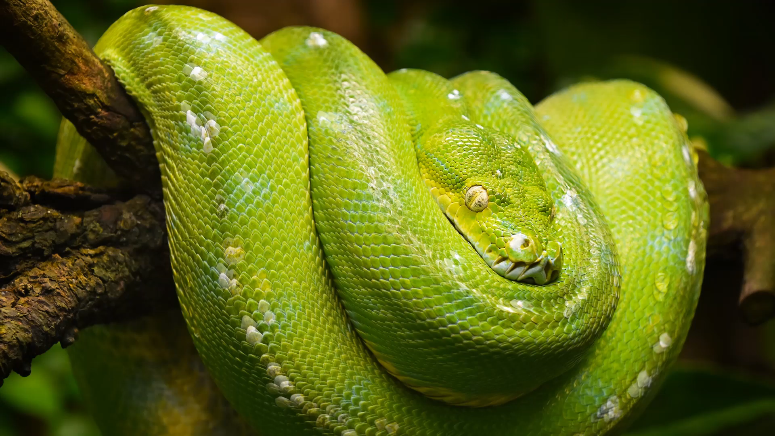
Polling Time How Well do you know Python? (the programming language one)

Slide 6

Data Science dan Artificial Intelligence
Notes:
https://www.python.org/dev/peps/pep-0008/

Slide 7

What is Data?

Slide 8
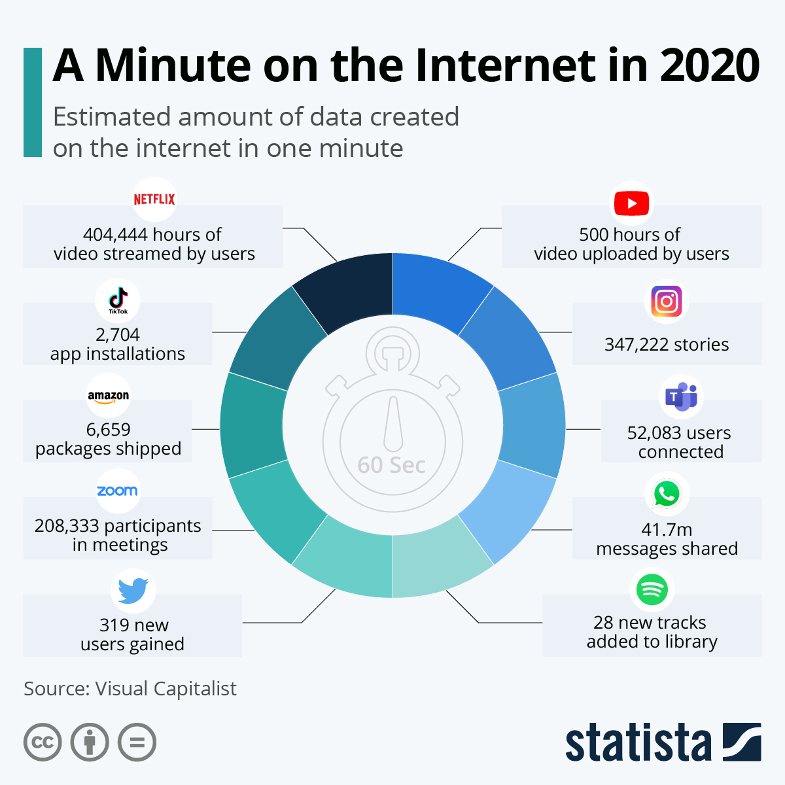


What’s with Data?
Data used to be very hard to collect.
Now, we are flooded with DATA
So Much DATA!
Notes:
https://www.python.org/dev/peps/pep-0008/

Slide 9
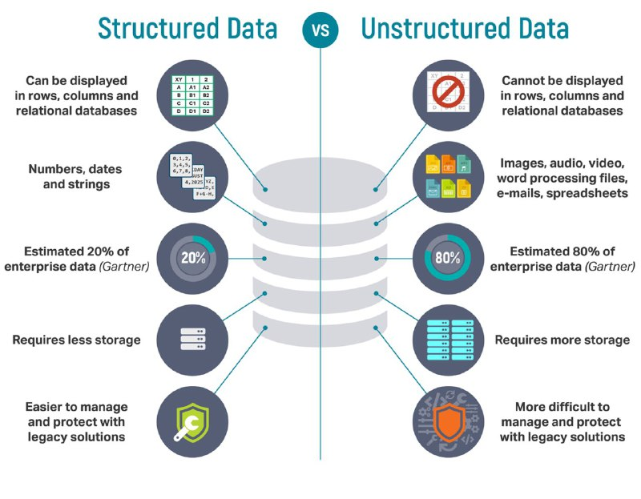
What’s with Data?
Selain data dalam jumlah besar, Sebagian data (termasuk data spasial) datang dalam bentuk tidak terstruktur
Notes:
https://www.python.org/dev/peps/pep-0008/

Slide 10
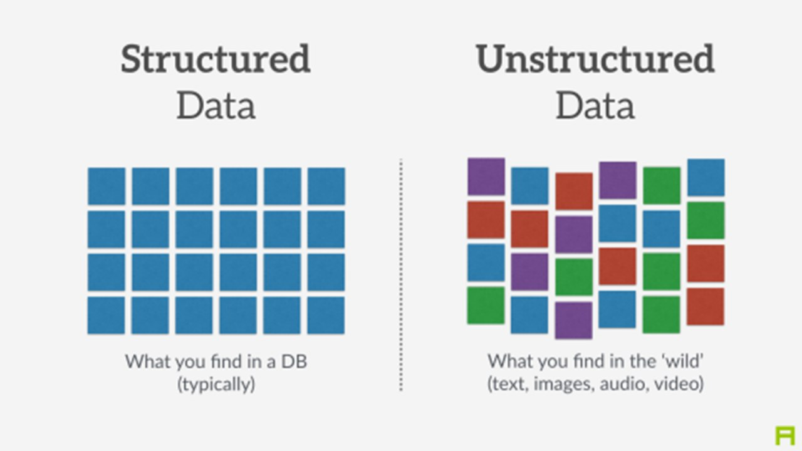
What’s with Data?
Notes:
https://www.python.org/dev/peps/pep-0008/

Slide 11
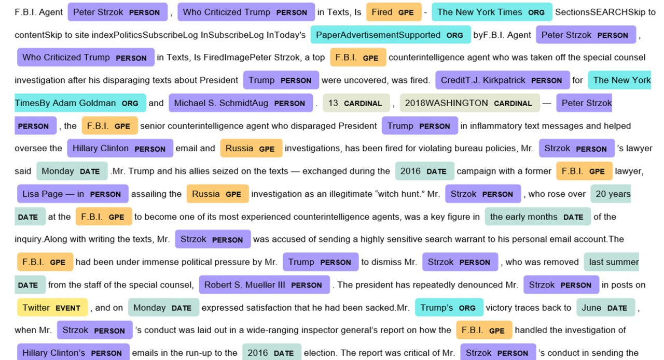
What’s with Data?
Notes:
https://www.python.org/dev/peps/pep-0008/

Slide 12
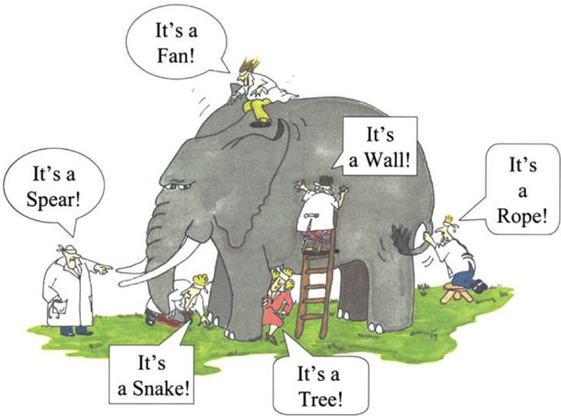
Mengapa Python?
Notes:
https://www.python.org/dev/peps/pep-0008/

Slide 13
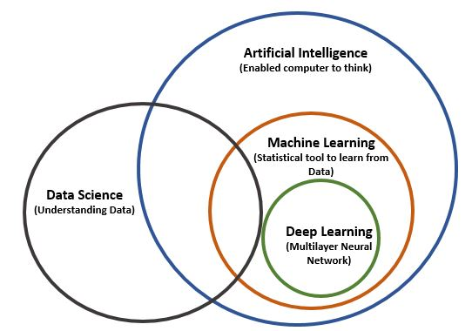
Data Science dan Artificial Intelligence
Data Science utilized AI to gain insights from the messy data input
Notes:
https://www.python.org/dev/peps/pep-0008/

Slide 14
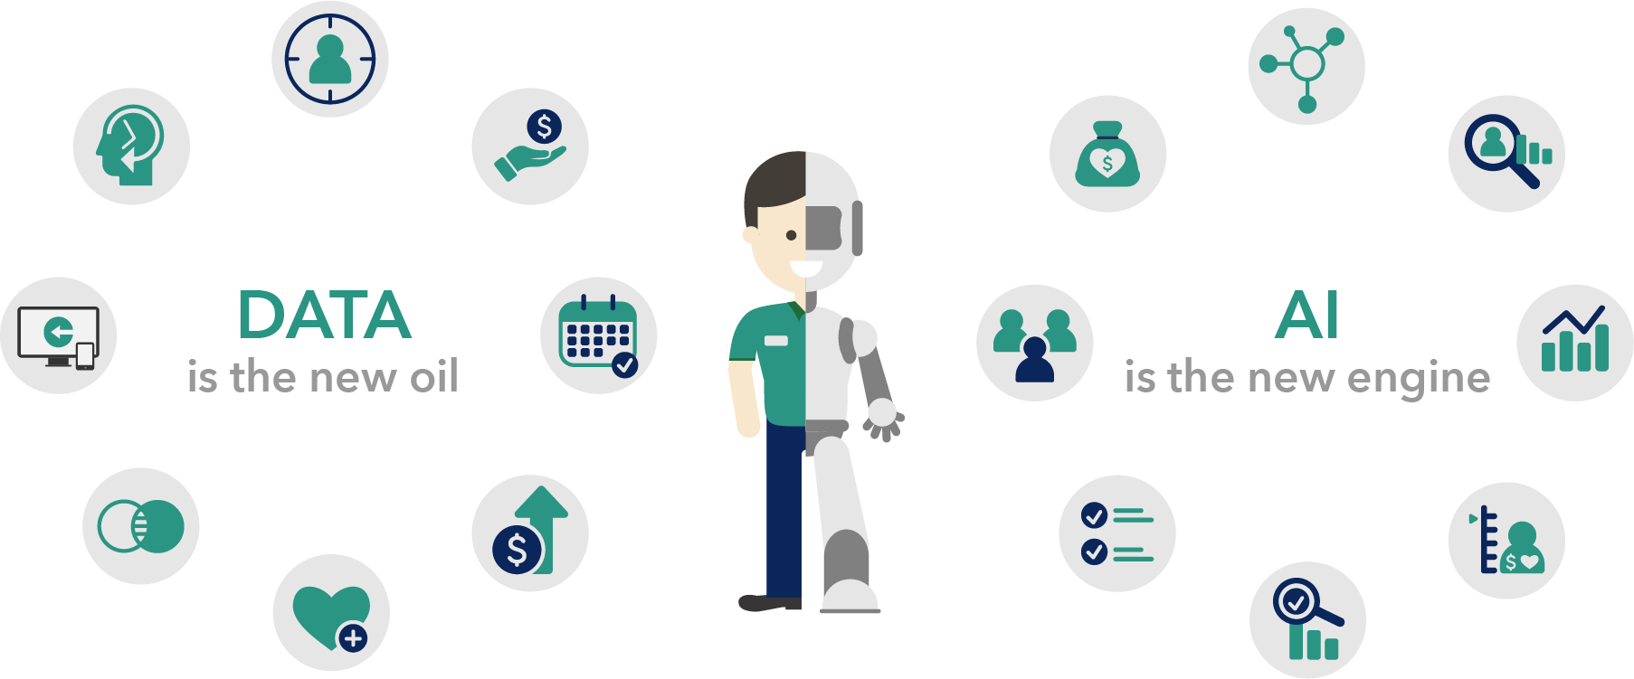
Data Science dan Artificial Intelligence
Notes:
https://www.python.org/dev/peps/pep-0008/

Slide 15
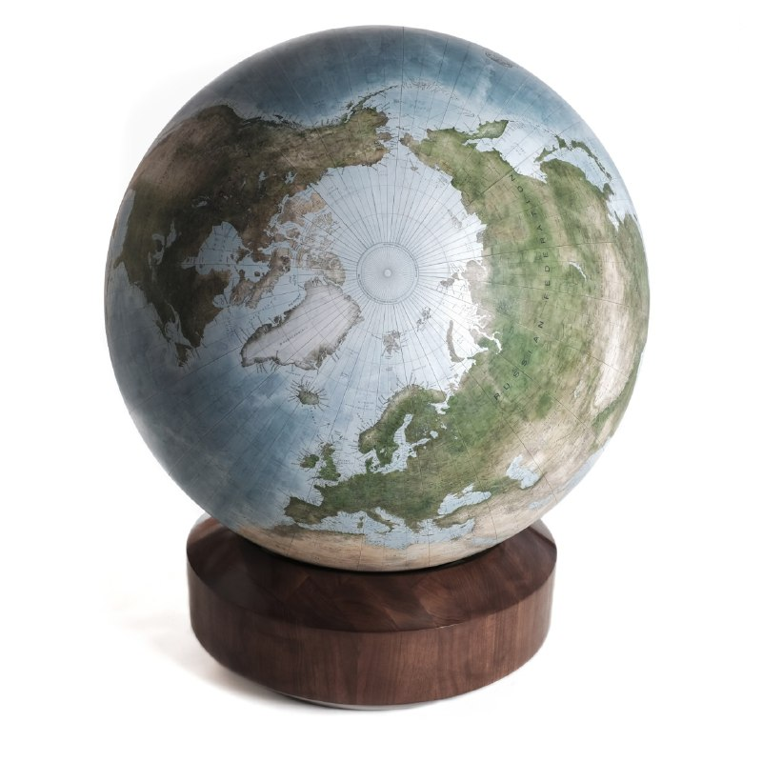
(Geospatial)
Data Science
Can you think of any Geospatial-related Artificial Intelligence and Data science Applications?
Notes:
https://www.python.org/dev/peps/pep-0008/

Slide 16
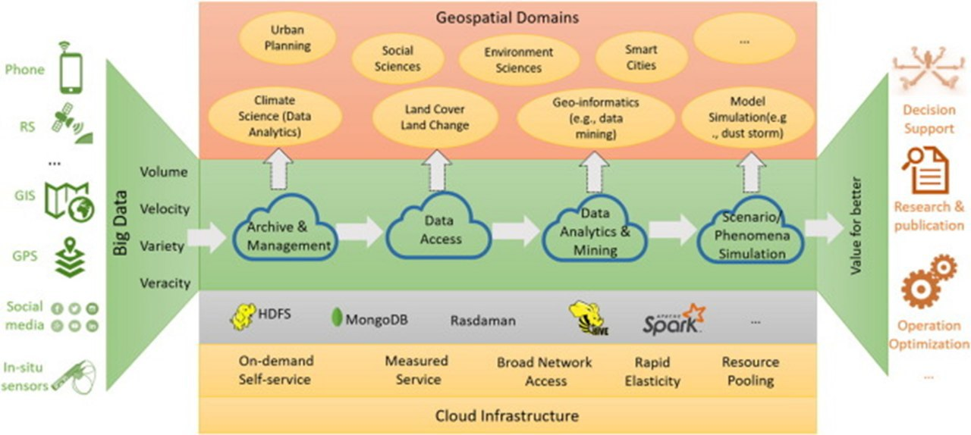
(Geospatial) Data Science
Can you think of any Geospatial-related Artificial Intelligence and Data science Applications?
Notes:
https://www.python.org/dev/peps/pep-0008/

Slide 17
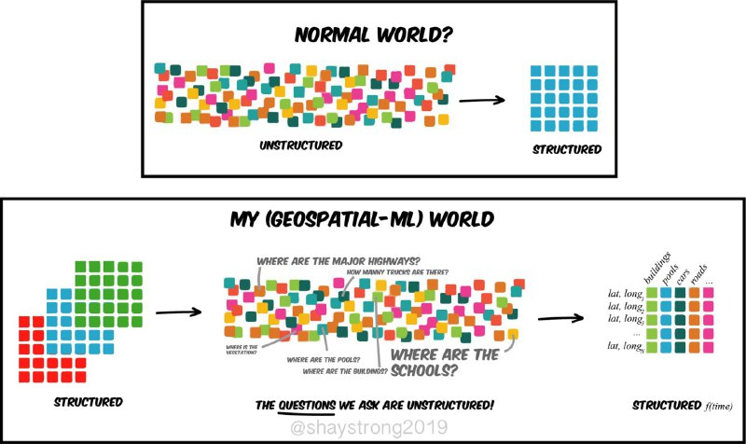
Notes:
https://www.python.org/dev/peps/pep-0008/

Slide 18
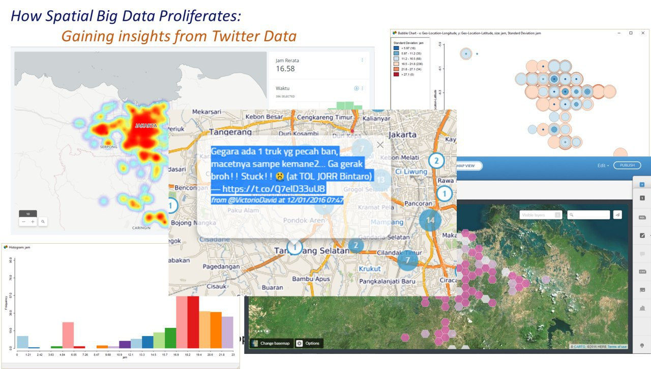
Notes:
https://www.python.org/dev/peps/pep-0008/

Slide 19
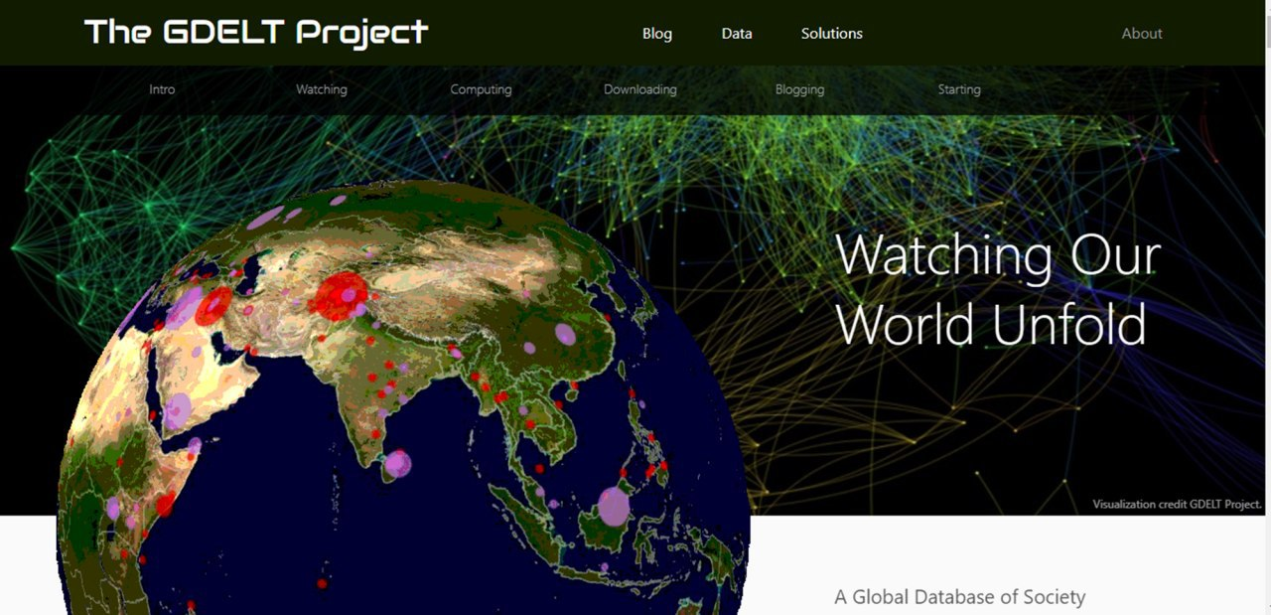
(Geospatial) Data Science
Notes:
https://www.python.org/dev/peps/pep-0008/

Slide 20
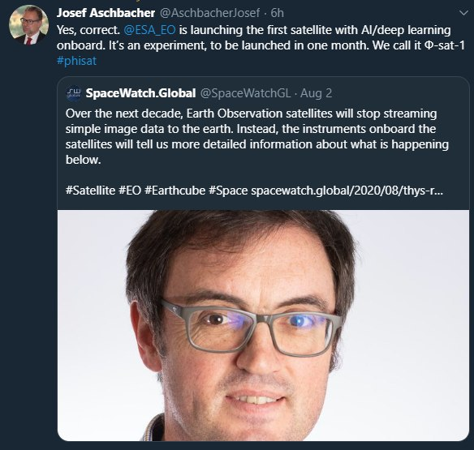
(Geospatial)
Data Science
Artificial Intelligence dan Data Science adalah Normal Baru untuk bidang Geospasial, meskipun Big Data, Statistik dan Machine Learning sudah digunakan sejak lama pada bidang ini
Notes:
https://www.python.org/dev/peps/pep-0008/

Slide 21
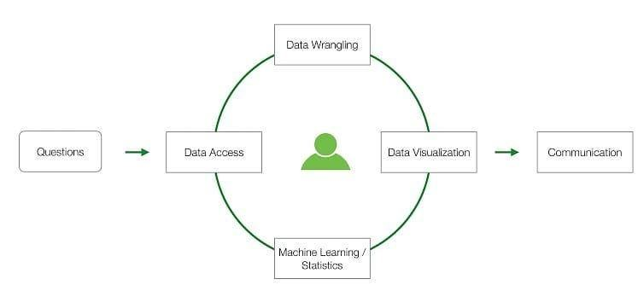
Data Science Workflow
Notes:
https://www.python.org/dev/peps/pep-0008/

Slide 22

Mengapa Python?
Notes:
https://www.python.org/dev/peps/pep-0008/

Slide 23

Mengapa Python?
Mengapa Python?
“Python is an excellent choice for most people to learn the basics of code, in the same way that everyone learns how to read and write. But the real beauty of Python is that it is also a language that can scale to large and complex software projects.”
-Tom Hatch
Notes:
https://www.python.org/dev/peps/pep-0008/
Python is the "most powerful language you can still read". - Paul Dubois

Slide 24
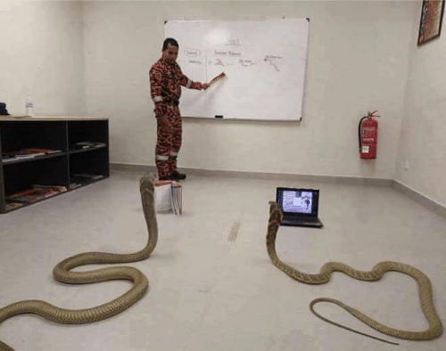
Mengapa Python?
Beautiful styling (`import this`);
Visually appealing (block through indentation);
Modular (209 ribu modul ++);
Capable of handling large and unstructured data easily
Easy for beginner
Complete documentation, mudah untuk otodidak
Notes:
https://www.python.org/dev/peps/pep-0008/

Slide 25
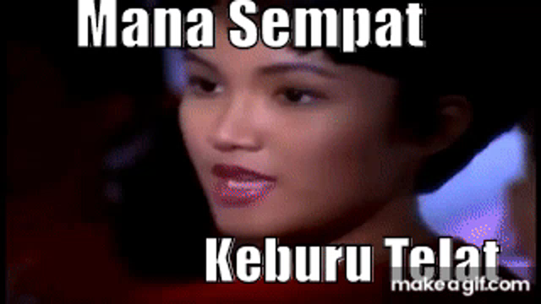
Mengapa Python?
Contoh:
Buat program untuk mencari bilangan Fibonacci ke 10.000
Notes:
Image sources:
malaymail.com

Slide 26

Mengapa Python?
Contoh:
Buat program untuk mencari Bilangan Fibonacci ke 10.000
Pythonic way:
1 | x=[0]*10005 | #inisialisasi array 0 sebanyak 10005; x[0]=0
2 | x[1]=1 | #x[1]=1
3 | for j in range(2,10001):
4 | x[j]=x[j-1]+x[j-2] | #Fibonacci
5 | print(x[10000]) | #isi array ke 10.000
Notes:
Image sources:
malaymail.com

Slide 27
Beberapa Karakteristik Python
Interpreted Language
Built-in & Third-party Libraries
Glue language
(i.e. APIs for APIs)
Blocks by Indentation
Dynamic (‘duck’) Typing
Wrappers. Lot’s of wrappers
Case Sensitive
Notes:
Image sources:
malaymail.com

Slide 28
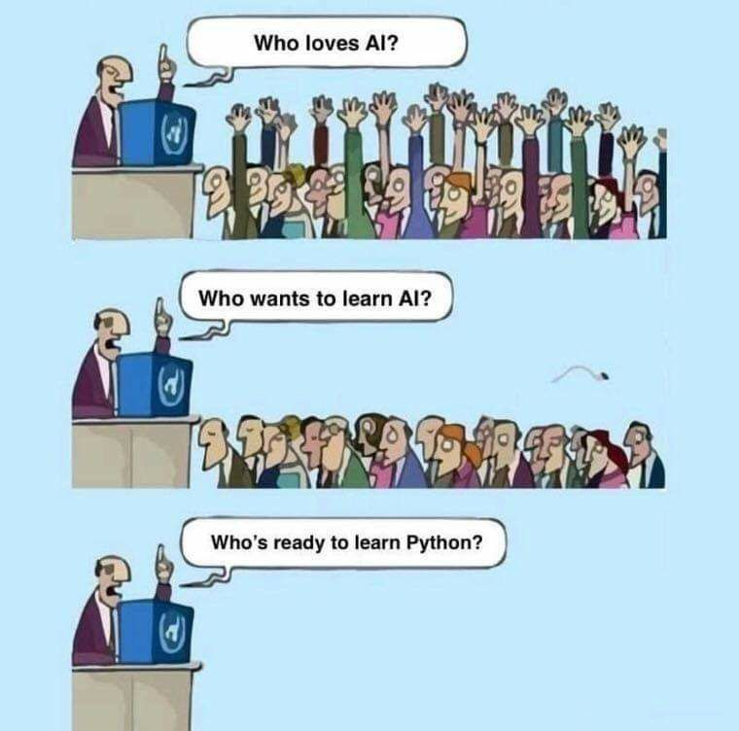
Mengapa Python?
Let’s start
Pythonizing, shall we
Notes:
https://www.python.org/dev/peps/pep-0008/

Slide 29

Dasar Python
Import statements
import numpy
import numpy, os, sys
from matplotlib import plot
from matplotlib import *
pip install geopandas
import geopandas
Built-in modules could be directly imported
Third-party modules needs installation first
Notes:
Image sources:
malaymail.com

Slide 30
Dasar Python
Variables
shapefileName = ‘batas_desa.shp’
ShapefileName = ‘batas_merapi.shp’
x = 1 # type of integer
x = ‘1’ # type of string
a, b, c = 5, 3.2, "Hello" # Multiple variables
x = y = z = "isinya sama"
x = 1 + '2'
Traceback (most recent call last):
File "<stdin>", line 1, in <module>
TypeError: unsupported operand type(s) for +: 'int' and 'str'
Case sensitive
Dynamic Typing
Notes:
Image sources:
malaymail.com

Slide 31
Dasar Python
Data Types
Text Type: | str
Numeric Types: | int, float, complex
Sequence Types: | list, tuple, range
Mapping Type: | dict
Set Types: | set, frozenset
Boolean Type: | bool
Binary Types: | bytes, bytearray, memoryview
Case sensitive
Dynamic Typing
Notes:
Image sources:
malaymail.com

Slide 32
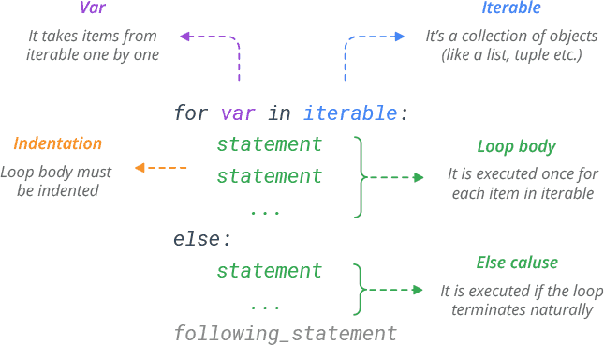
Dasar Python
Loop
Blocks in loop indicated by indentation
Iterable should be collection of objects or range
Zero-based indexing
newlist = ['run','chase','dog','bark']
for counter, item in enumerate(newlist):
print counter, newlist[counter]
Notes:
Image sources:
malaymail.com

Slide 33
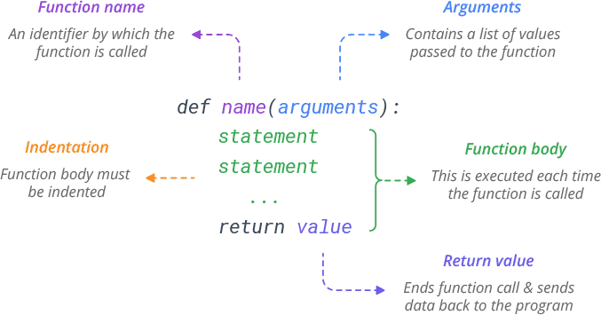
Dasar Python
Function
*args indicate tuple arguments
**kwargs indicate keyword arguments
def func(name, job):
print(name, 'is a', job)
func('Bob', 'developer')
def print_arguments(**kwargs):
print(kwargs)
print_arguments(name='Bob', age=25)
Notes:
https://www.learnbyexample.org/python-functions/

Slide 34
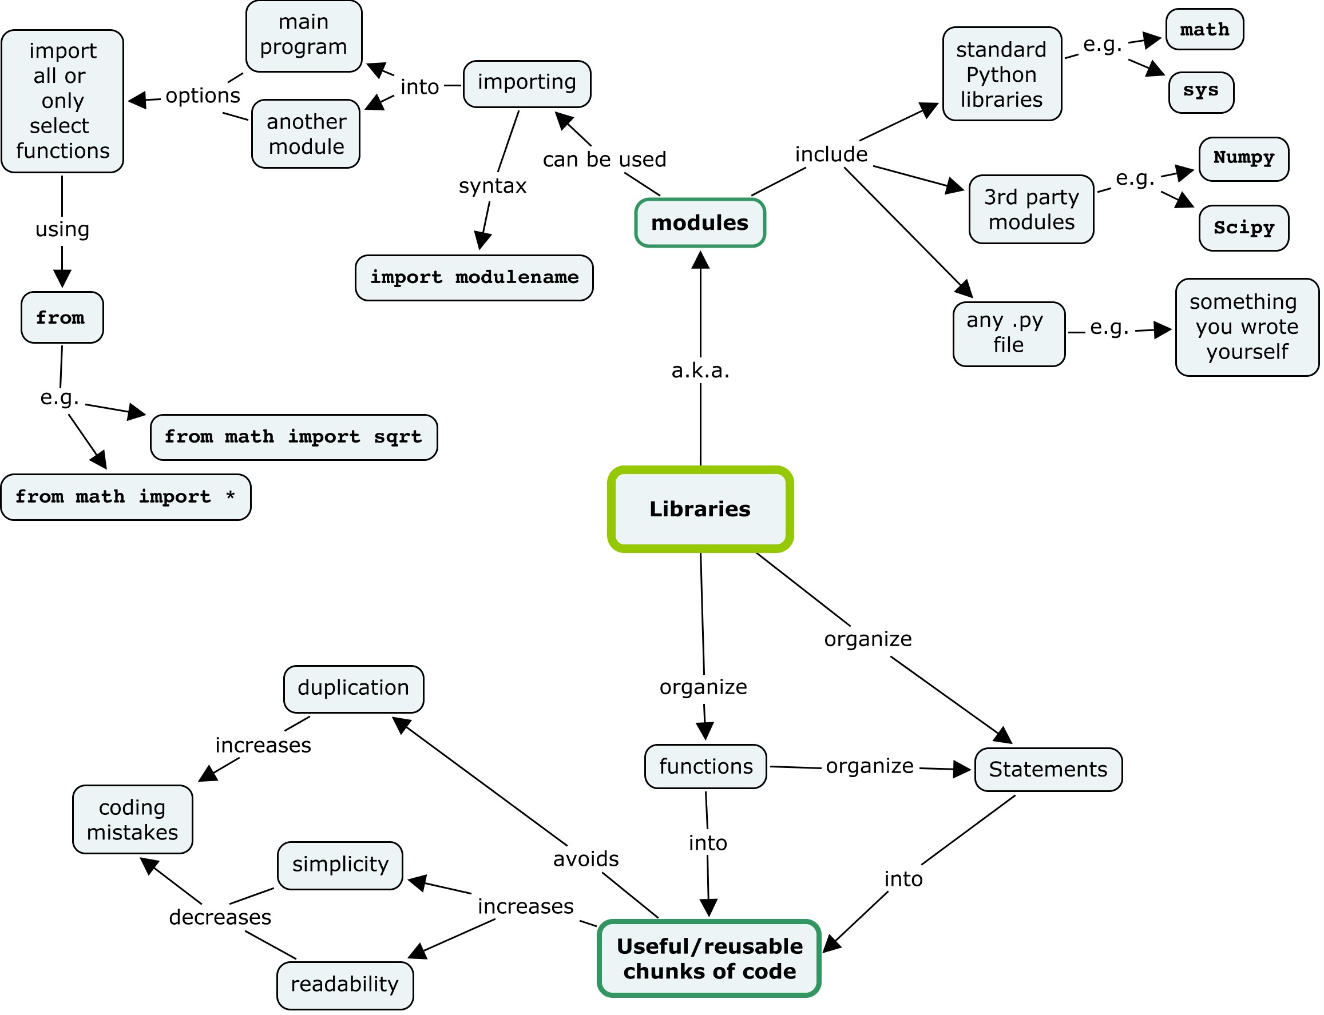
Modul pada Python
Notes:
http://swcarpentry.github.io/training-course/2012/09/week-1-python-libraries/

Slide 35
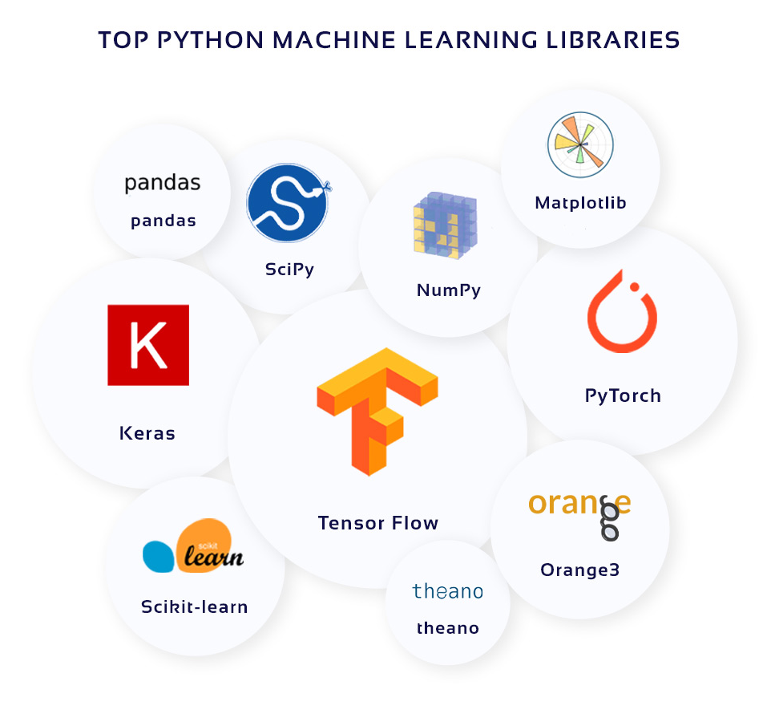
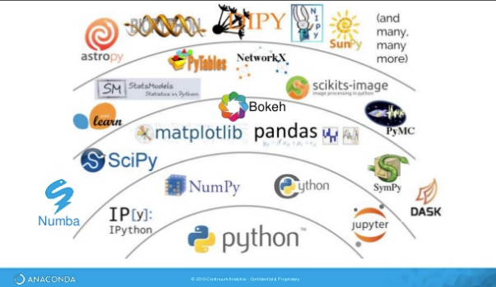
Review Dasar Python
Notes:
https://www.learnbyexample.org/python-functions/

Slide 36
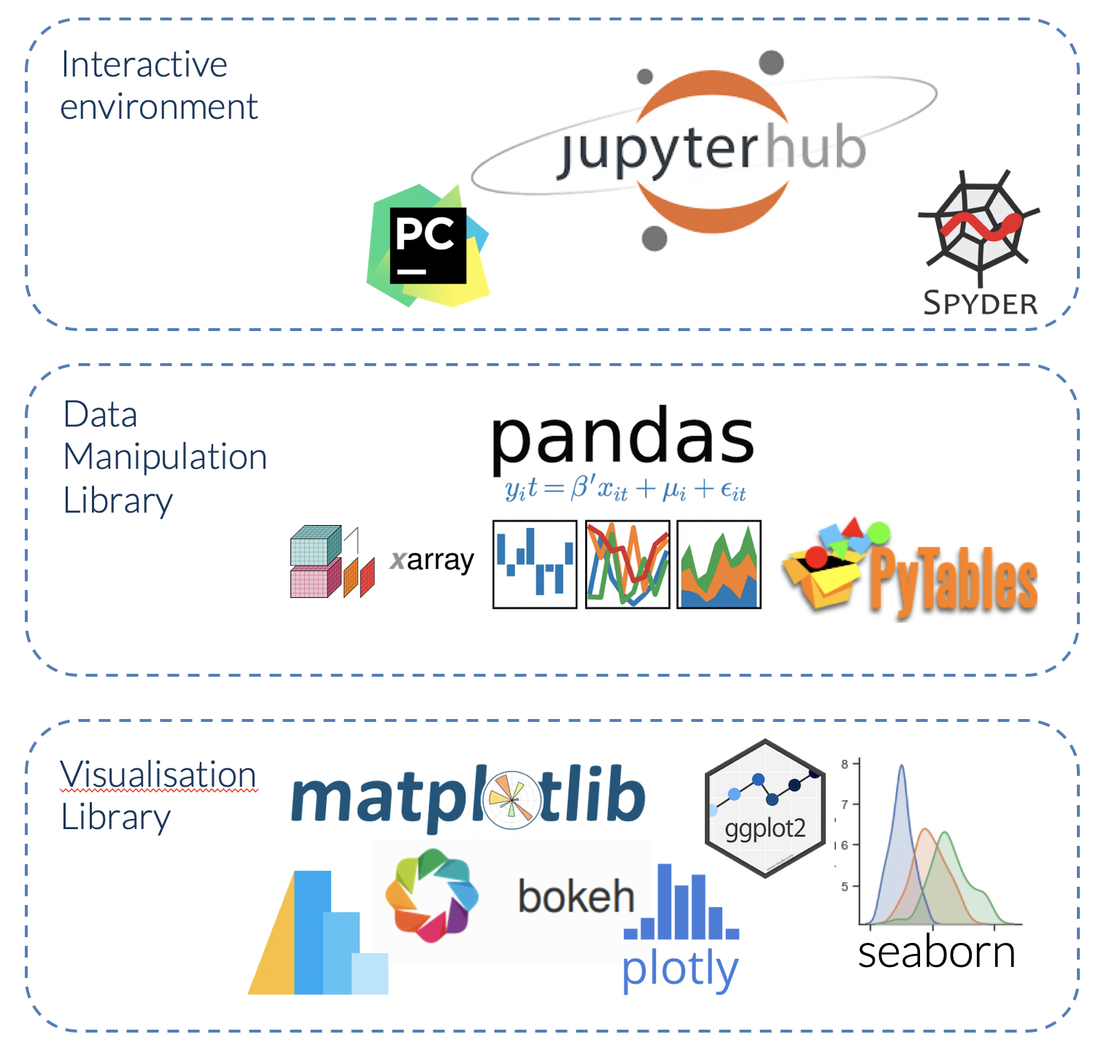
Modul pada Python
Currently 209 ribu modules (and counting++)
Third-party modules for every thinkable purposes: ranging from data analysis and visualization from many fields
Notes:
https://www.learndatasci.com/tutorials/python-pandas-tutorial-complete-introduction-for-beginners/

Slide 37

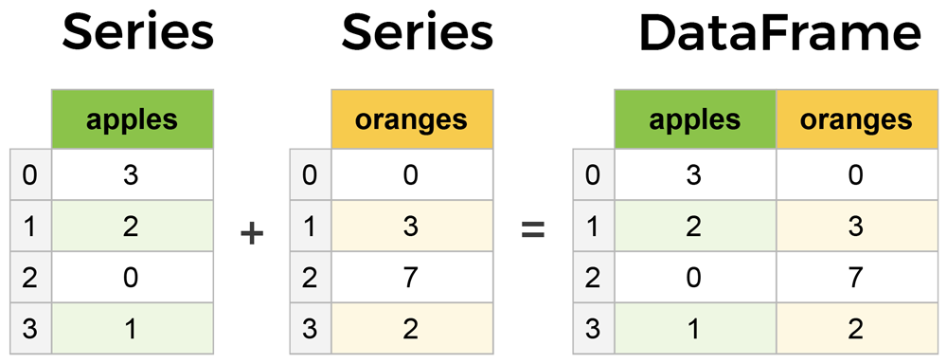
Modul-modul Python: Pandas
import pandas as pd
data = {
'apples': [3, 2, 0, 1],
'oranges': [0, 3, 7, 2]}
purchases = pd.DataFrame(data)
purchases =
Notes:
https://www.learnbyexample.org/python-functions/

Slide 38
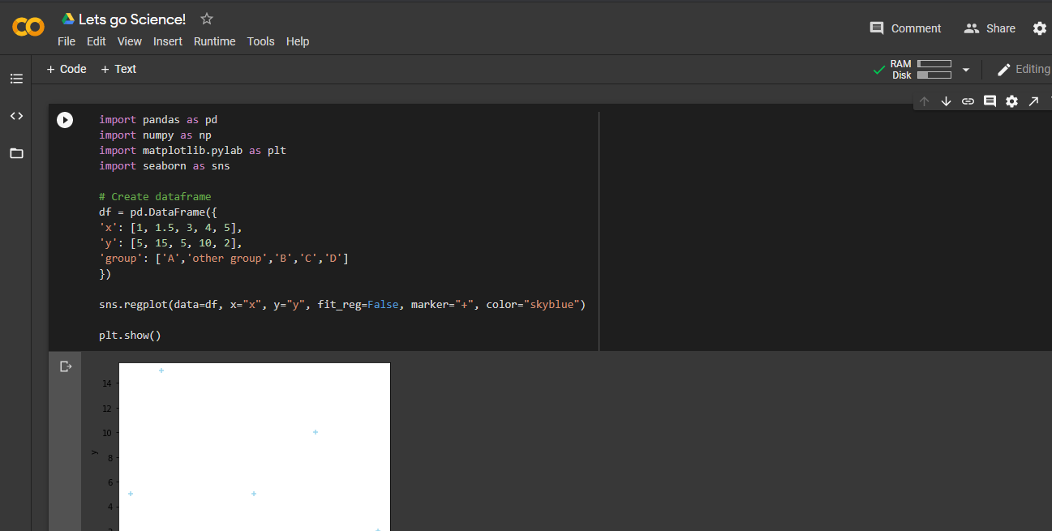
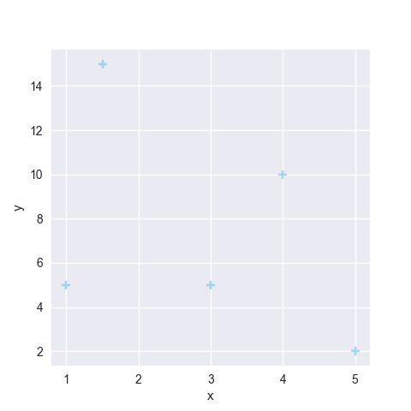
Modul-modul Python: visualisasi sederhana
import pandas as pd
import numpy as np
import matplotlib.pylab as plt
import seaborn as sns
# Create dataframe
df = pd.DataFrame({
'x': [1, 1.5, 3, 4, 5],
'y': [5, 15, 5, 10, 2],
'group': ['A','other group','B','C','D']
})
sns.regplot(data=df, x="x", y="y", fit_reg=False, marker="+", color="skyblue")
plt.show()
https://python-graph-gallery.com/
Notes:
https://www.learnbyexample.org/python-functions/

Slide 39
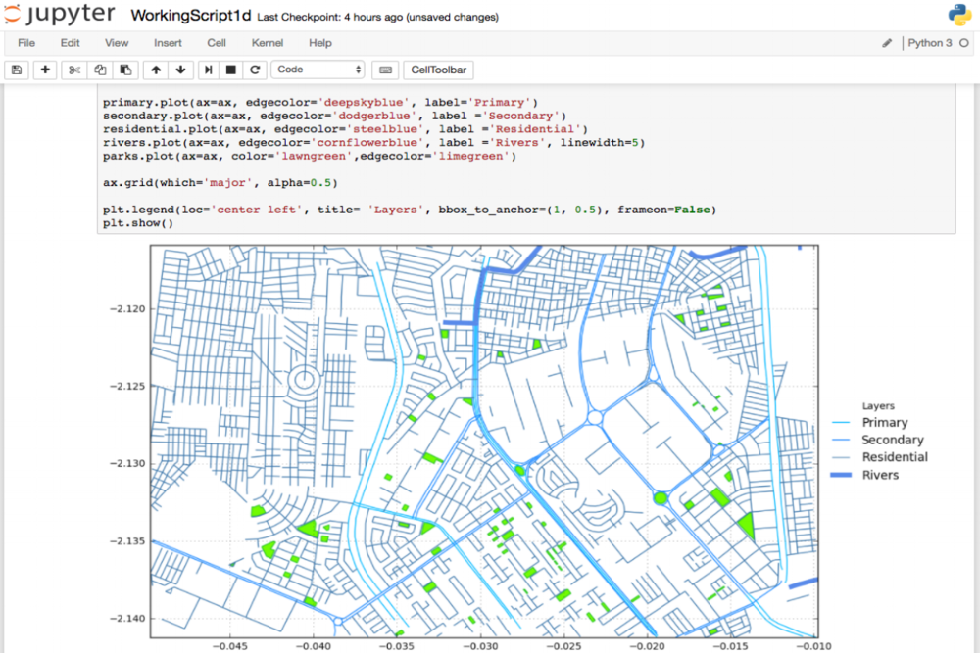
Modul-modul Python: Analisis Spasial?
Notes:
https://www.learnbyexample.org/python-functions/

Slide 40

Jupyter Notebook dan Google Colab
Notes:
Image sources:
https://medium.com/@northof41/what-really-is-the-difference-between-ar-mr-vr-xr-35bed1da1a4e

Slide 41
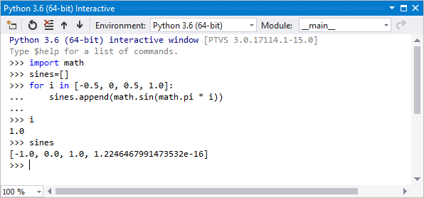
Antarmuka Interactive Python
Python in Desktop ArcGIS

Slide 42
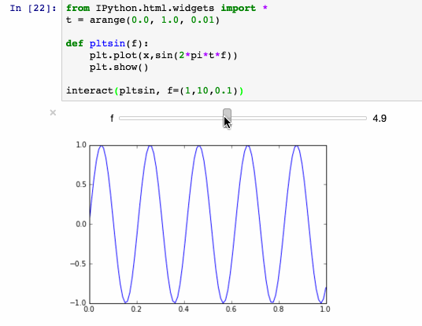
Antarmuka Interactive Python
Ipython Notebook:
Python dijalankan dalam bentuk Cell
Tiap notebook merupakan sebuah Environment Python yang berdiri sendiri
Notes:
Image sources:
https://medium.com/@northof41/what-really-is-the-difference-between-ar-mr-vr-xr-35bed1da1a4e

Slide 43
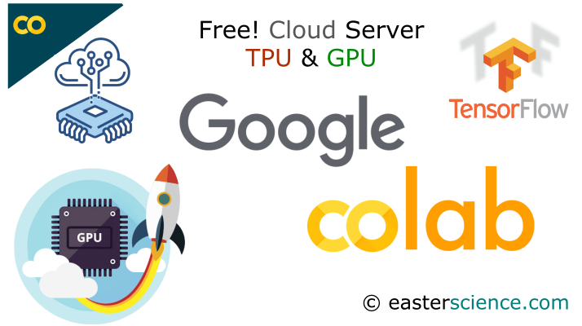
Google Colaboratory
Google memberikan Colab secara gratis untuk mendorong penelitian data science dan Machine Learning
Notes:
Image sources:
https://medium.com/@northof41/what-really-is-the-difference-between-ar-mr-vr-xr-35bed1da1a4e

Slide 44
Questions?

Slide 45

TERIMA KASIH

